Slide 1
4.1.1. c – DNA Replication
TEXT - 7.4 REPLICATION OF DNA

Slide 2
Learning intention Success criteria
Explain the role of helicase (in terms of unwinding the double helix and separation of the strands) and DNA polymerase (in terms of formation of the new complementary strands) in the process of DNA replication. Reference should be made to the direction of replication.
Describe in more detail the role of helicase (in terms of unwinding the double helix and separation of the strands) and DNA polymerase (in terms of formation of the new complementary strands) in the process of DNA replication. Reference should be made to the direction of replication

Slide 3
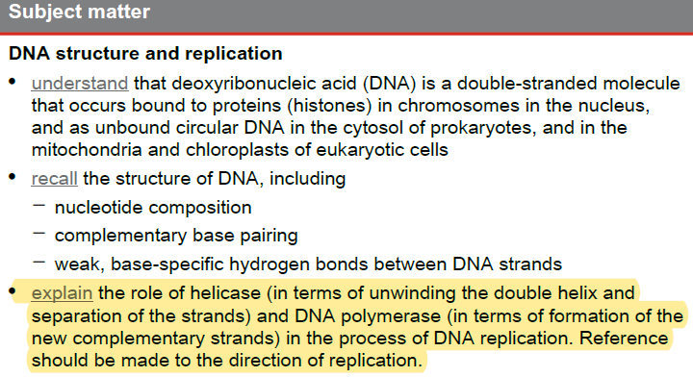
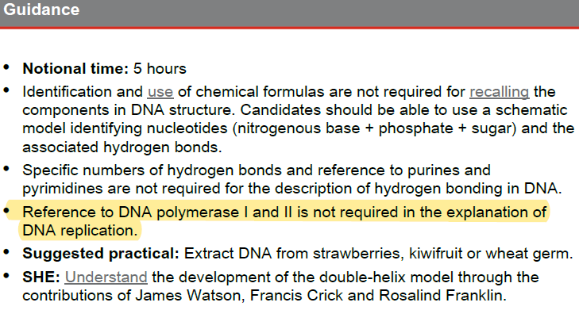
Syllabus check:
By the end of the lesson you should be able to…
NOTE SPECIFICALLY….

Slide 4
WHY DOES DNA REPLICATE?
You (and other multicellular organisms) started life as a single cell. By the time you reach adulthood you are built from trillions of semi-independently functioning cells of hundreds of types. The vast majority of these cells possesses the entire complement of 46 chromosomes that was carried by that first fertilised egg cell. Between these two points in time your cells must replicate, this process is call cellular division. As each cell must be able to function it must possess a full complement of those original chromosomes (there are some exceptions to this rule), therefor, before a cell can divide it must make a copy of its chromosomes. This process is call DNA replication.

Slide 5
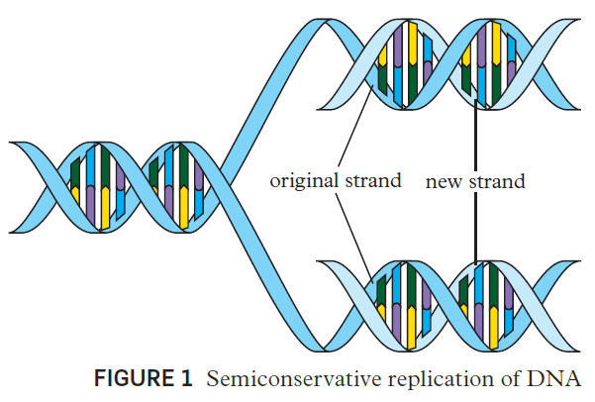
DNA Replication
DNA replication is termed semiconservative replication because each replicated DNA contains one strand of the original DNA and one new strand. Free nucleotides, which are formed in the cytoplasm, pass through the pores of the nuclear membrane to be available for DNA replication (or the formation of messenger RNA for protein synthesis). A variety of cellular processes occur to prevent mutations or mistakes in replication. These involve proofreading and error checking to ensure that replicated DNA are exact copies of the parent DNA.

Slide 6
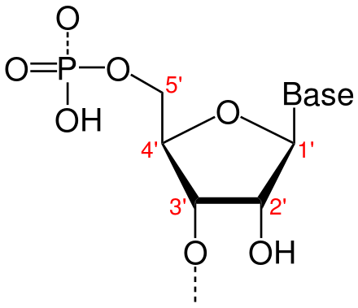
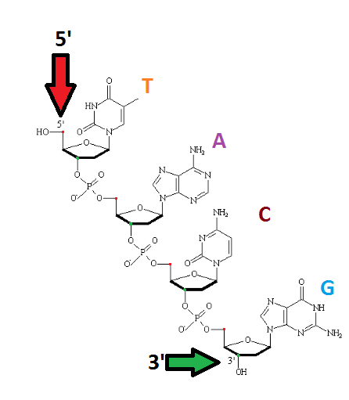
DNA directionality
From Figure2, it can be seen that the two DNA strands have directionality. Each strand has a 3 (three-prime) end, named after the C3 carbon atom of the sugar molecule that has a ‘free’ OH (hydroxyl) group that is not linked. The opposite end of each strand ends in a 5(five-prime) end, named after the C5 carbon atom of the sugar molecule that is linked to the phosphate. Each nucleotide on the complementary strand is reversed. The strands of the double helix therefore run from 3 to 5 on the left strand and from 5 to 3 on the opposite strand– they are antiparallel. This directionality is important in DNA replication because the enzyme DNA polymerase can only synthesise DNA in one direction, by adding nucleotides to the 3 end of the template DNA.

Slide 7
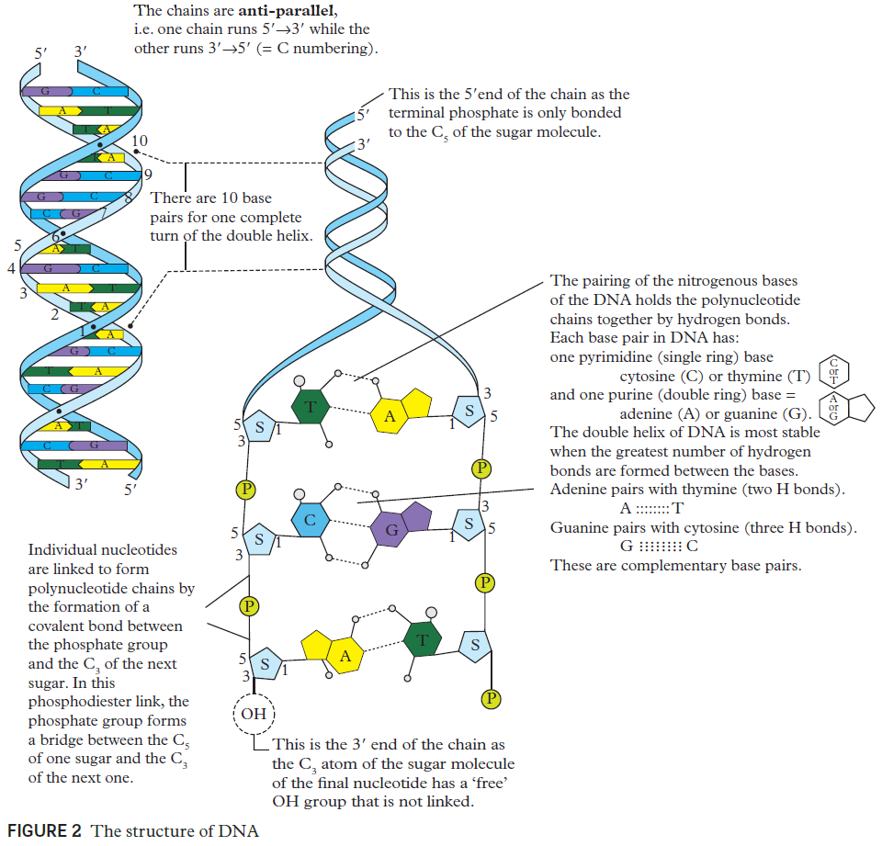

Slide 8
DNA Replication
DNA replication occurs in four main steps:
separation of DNA strands (DNA helicase)
Initiation
Elongation (DNA polymerase)
termination.
All of these steps involve complex enzyme-controlled and coordinated processes.

Slide 9
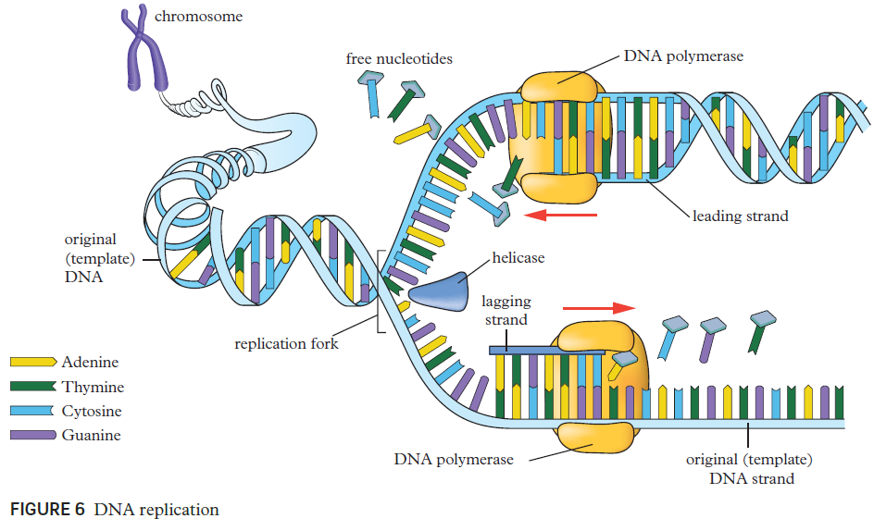
Separation: helicase
Before replication can happen, the DNA must first be unwound and unzipped by an enzyme called DNA helicase.
This enzyme unwinds then separates the two stands of parent DNA by breaking the hydrogen bonds between the nitrogen bases.
This results in the exposure of the two strands of nucleotide bases in the formation called the replication fork.

Slide 10
Elongation: DNA Polymerase
Before DNA replication can occur, an RNA primer (a short strand of RNA) must bind to the starting point of replication. This occurs at set recognition points along the DNA template strands.
The enzyme DNA polymerase moves along the exposed nucleotides generating new DNA strands that are complementary to the ‘original’ template strands, added to the 3’ end.
The DNA polymerase then proofreads the newly synthesised strands of DNA to reduce the chance of mistakes.
Draw a diagram

Slide 11
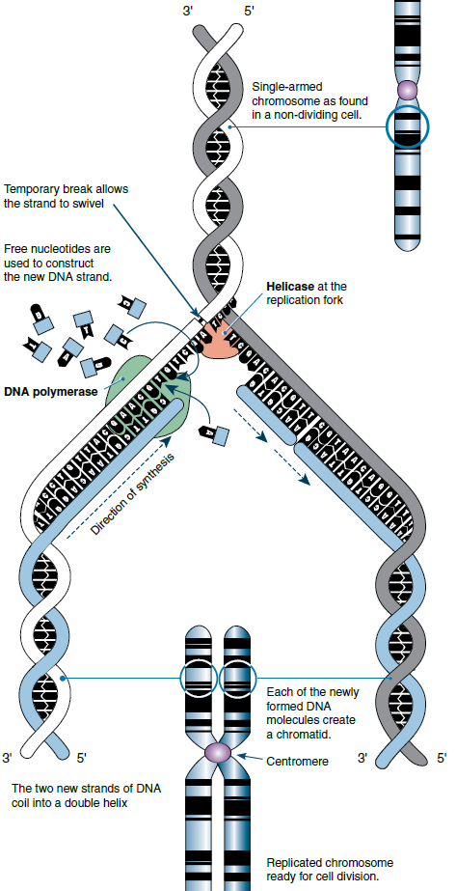
Elongation direction
DNA polymerase can only add new nucleotides to the 3 end of the previous nucleotide. This means the formation of the new complementary DNA strand will start from the 3 end of the RNA primer and move in opposing directions for each DNA template. This means the strand is synthesised in a 5’ to 3’ direction (with new bases added to the 3’ end of the new strand) with the polymerase moving 3’ to 5’ along the strand it is reading. Thus the nucleotides are assembled in a continuous fashion on one strand (called the ‘Leading Strand’) but in short fragments on the other strand (called the ‘Lagging Strand’).

Slide 12
Termination
Each of the new double-helix DNA molecules has one strand of the original DNA (dark grey and white in the diagram) and one strand that is newly synthesised (blue). The two DNA molecules rewind into their double-helix shape again

Slide 13
Exit ticket: c. Explain the role of helicase (in terms of unwinding the double helix and separation of the strands) and DNA polymerase (in terms of formation of the new complementary strands) in the process of DNA replication. Reference should be made to the direction of replication. EXTERNAL EXAM 2020 SA 2
QUESTION 3 (4 marks)
Explain the role of the enzymes helicase and DNA polymerase in the process of DNA replication.

Slide 14
Further research
DNA Structure and Function.
“DNA” (Khan Academy)
https://www.youtube.com/watch?v=_-vZ_g7K6P0
2. DNA Structure and Replication.
“DNA Structure and Replication: Crash Course Biology #10” (Crash Course)
https://www.youtube.com/watch?v=8kK2zwjRV0M

